Slide 1
10 June 2020
1

Slide 2

APPLIED CRYPTOGRAPHY
Lecture 26
2

Slide 3
Public Key Cryptography
Pairs of Keys
3

Slide 4
Overview
Private and Public-key cryptography will exist in parallel and continue to serve the community.
We actually believe that they are complements of each other;
The advantages of one can compensate for the disadvantages of the other.
4

Slide 5
Topics discussed in this section
Establishing a shared secret
Introduction to Public Key Cryptography
Pair of Keys
Why Public-Key Cryptography?
General Idea of Public Key Cryptosystem
Characteristics
Formal Definition
Security against Chosen-plaintext Attacks
Differences between Private and Public key cryptography
Applications
Security of Public key Cryptography
5

Slide 6




Establishing a shared secret
Goal: Alice and Bob want shared secret, unknown to eavesdropper
Security against eavesdropping (No tampering)
6

Slide 7
Introduction to Public Key Cryptography
The Public key cryptography was first invented by
Whitefield Diffie
Martin Hellman
Ralph Merkle
7

Slide 8
Pair of Keys
Generated by the user himself
Public key - known by anybody and can be used to encrypt messages
Private key - known only to the recipient and used to decrypt messages
8

Slide 9






Continued..
9

Slide 10
Why Public-Key Cryptography?
Address two key issues:
Authentication - how to verify a message comes intact from the claimed sender
Key distribution - how to have secure communications in general without having to trust a KDC with your key
Also called as Asymmetric because those who encrypt
messages cannot decrypt messages
10

Slide 11
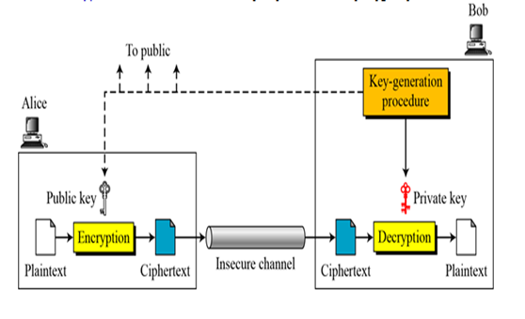
General Idea of Public Key Cryptosystem
Plaintext
Encryption algorithm
Public key
Private key
Ciphertext
Decryption algorithm
11

Slide 12
Continued..
Plaintext/Ciphertext
Unlike in symmetric-key cryptography, plaintext and ciphertext are treated as integers in asymmetric-key cryptography.
Encryption/Decryption
C = f (K_{public} , P) P = g(K_{private} , C)
12

Slide 13
Characteristics
Public-key algorithms rely on two keys where:
Computationally infeasible to find decryption key knowing only algorithm and encryption key
Computationally easy to en/decrypt messages when the relevant(en/decrypt) key is known
Either of two related keys can be used for encryption, with the other used for decryption
13

Slide 14
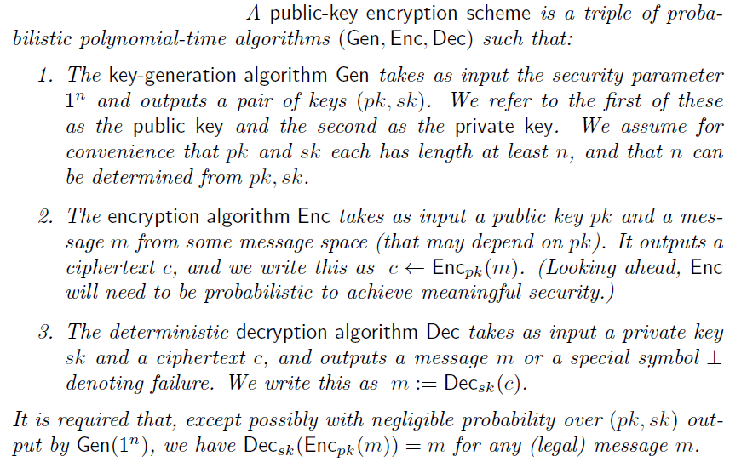
Formal Definition
14

Slide 15
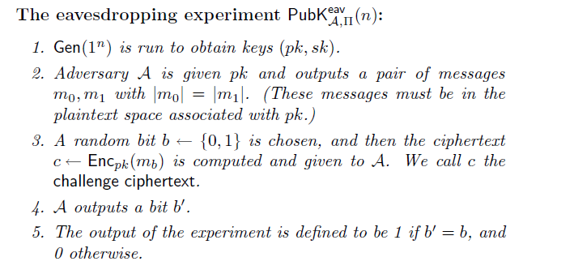
Security against Chosen-plaintext Attacks
Given a public-key encryption scheme = (Gen; Enc; Dec) and an adversary A, consider the following experiment:
10 June 2020
15

Slide 16
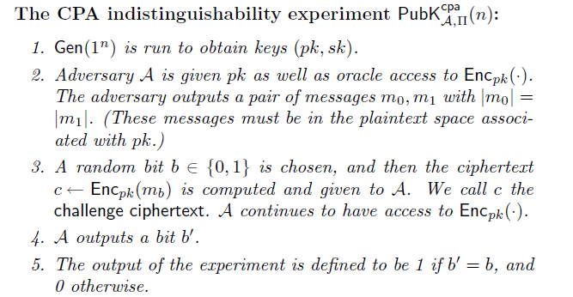
Security against Chosen-plaintext Attacks
Consider the following experiment defined for public-key encryption
scheme = (Gen; Enc; Dec) and adversary A:
16

Slide 17
Differences between Private and Public key Cryptography
Private Key Encryption | Public Key Encryption
Uses one key for encryption and decryption | Uses two keys(public and private keys) for encryption and decryption
Key must be kept secret | One key must be kept secret and other can be freely exposed
Low power consumption | Higher power consumption
Speed in performance | Slow in performance
Inexpensive to generate | Expensive to generate
17

Slide 18
Continued ..
Private Key Encryption | Public Key Encryption
Randomly generated k-bits strings | Have special structures Ex: Large prime numbers
Best used for secrecy and integrity of data | Best used for key exchange and authentication
Key distribution is problematic | Key distribution is safer
Example: Advanced Encryption Standard Triple Data Encryption Standard | Example: Elliptic curve cryptography RSA algorithm Diffie-Hellman key exchange Digital Signature algorithm
18

Slide 19
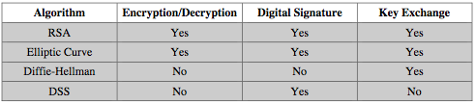
Applications
Encryption/Decryption(provide Secrecy)
Digital Signature(provide authentication)
Key Exchange(of Session key)
Some algorithms are suitable for all uses, others are specific to one
19

Slide 20
Security of Public-Key Cryptography
Like private key schemes brute force exhaustive search attack is always theoretically possible
But keys used are too large (>512bits)
Security relies on a large enough difference in difficulty between easy (en/decrypt) and hard (cryptanalyse) problems
More generally the hard problem is known, but is made hard enough to be impractical to break
Requires the use of very large numbers
Hence is slow compared to private key schemes
20

Slide 21
Thank You!
Next Class
Mandatory reading for the next class
https://math.berkeley.edu/~kpmann/encryption.pdf
21

Slide 22


Vineetha B
Computer Science and Engineering
PES University, Bengaluru
22

